Slide 1

Blockchain
Prof. Sunitha R
Department of Computer Science and Engineering

Slide 2

Blockchain
Proof of Authority (PoA) & Proof of Elapsed Time (PoET)
Prof. Sunitha R
Department of Computer Science and Engineering

Slide 3
Blockchain
Consensus Algorithm – Proof of Authority (PoA)
Best suited for private, permissioned Blockchain.
The term was proposed in 2017 by Ethereum co-founder and former CTO Gavin Wood.
Collaborative consensus algorithm
Transactions and blocks are validated by approved accounts
Validator nodes run consensus software.
Used for test networks that are used to test applications before they are deployed on public networks.

Slide 4
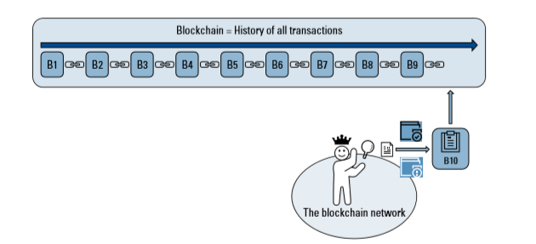
Blockchain
Consensus Algorithm – Proof of Authority (PoA)

Slide 5
Blockchain
Conditions for Proof of Authority Consensus
The conditions may vary from system to system, the PoA consensus algorithm is usually reliant upon:
valid and trustworthy identities
difficulty to become a validator
a standard for validator approval
Notes:
The conditions may vary from system to system, the PoA consensus algorithm is usually reliant upon:
valid and trustworthy identities: validators need to confirm their real identities.
difficulty to become a validator: a candidate must be willing to invest money and put his reputation at stake. A tough process reduces the risks of selecting questionable validators and incentivize a long-term commitment.
a standard for validator approval: the method for selecting validators must be equal to all candidates.

Slide 6
Blockchain
Consensus Algorithm – Proof of Authority (PoA)
Examples:
POA Network – https://poa.network
Ethereum Rinkeby Testnet – https://www.rinkeby.io
Pros:
Energy efficient
Fast
Cons:
Centralized
PoA is used by PoA Network, Ethererum Kovan test net and Vechain

Slide 7
Blockchain
Consensus Algorithm – Proof of Elapsed Time (PoET)
Competitive consensus algorithm
Permissioned Blockchain
Participants Identify themselves before join
Sawtooth lake project on Hyperledger
Built to run in a secure area of the central processor of Computer called a trusted execution environment (TEE)

Slide 8
Blockchain
Consensus Algorithm – Proof of Elapsed Time (PoET)
Lottery based system that randomly selects a node from pool of validating nodes.
The probability of a node being selected increases in line with how much processing resource the node has contributed to that Blockchain.
Control cost of consensus process
Internal project or all participants are known.
Used to build decentralized applications.

Slide 9
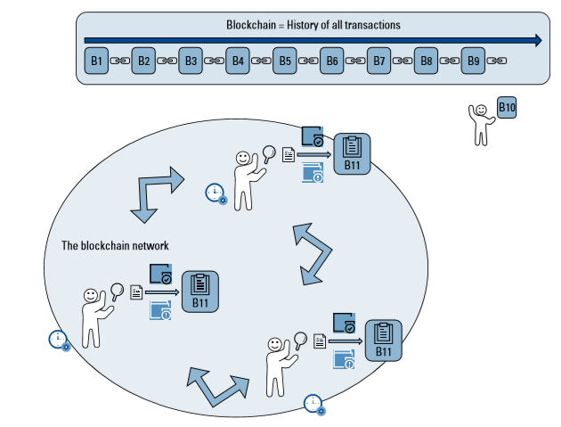
Blockchain
Consensus Algorithm – Proof of Elapsed Time (PoET)

Slide 10
Blockchain
Verification
How will one verify that the proposer has really waited for a random amount of time?
The PoET algorithm is for permissioned blockchain networks.
A special verification is required from a node when it tries to join the network.
This verification is achieved using Intel’s Software Guard Extension (SGX) technology which was first introduced in 2015.
It creates an attestation for a piece of code and protects the code from external access.

Slide 11
Blockchain
Process
The network operates in the following way:
A node downloads the PoET code and generates an attestation (key) for the code using SGX.
The node forwards this key when requesting to join the network.
The new node now has its own timer object which is initialized to a random value.
All nodes are initialized with a random time;

Slide 12
Blockchain
P2P PoET SGX Enclave Specifications
The P2P PoET SGX enclave uses the following data structures:
WaitTimer {
double requestTime
double duration
byte[32] WaitCertId:sub:`n`
double localMean
}
WaitCertificate {
WaitTimer waitTimer
byte[32] nonce
byte[] blockDigest
}
https://sawtooth.hyperledger.org/docs/core/releases/1.0/architecture/poet.html

Slide 13
Blockchain
Consensus Algorithm – Proof of Elapsed Time (PoET)
Pros
Low cost of upkeen
Scalable to operation
Cons
Needs specialized hardware
Must know participants in the network
PoET is used by Hyperledger- sawtooth lake project.

Slide 14
Blockchain
Supplementary Readings
https://ieeexplore.ieee.org/document/8751260
https://youtu.be/-C19r0UsYws

Slide 15
THANK YOU
Prof. Sunitha R
Department of Computer Science and Engineering
sunithar@pes.edu

